Slide 1

Brain-Computer Interfaces
Zhitnikova Liudmila - 301162588
Tsang Tsz Long - 301206736
Hasan Arda Erbil - 301192402
Rodrigo Almeida - 301199371
Centennial College
COMP120 Software Engineering Fundamentals (SEC.005)

Slide 2
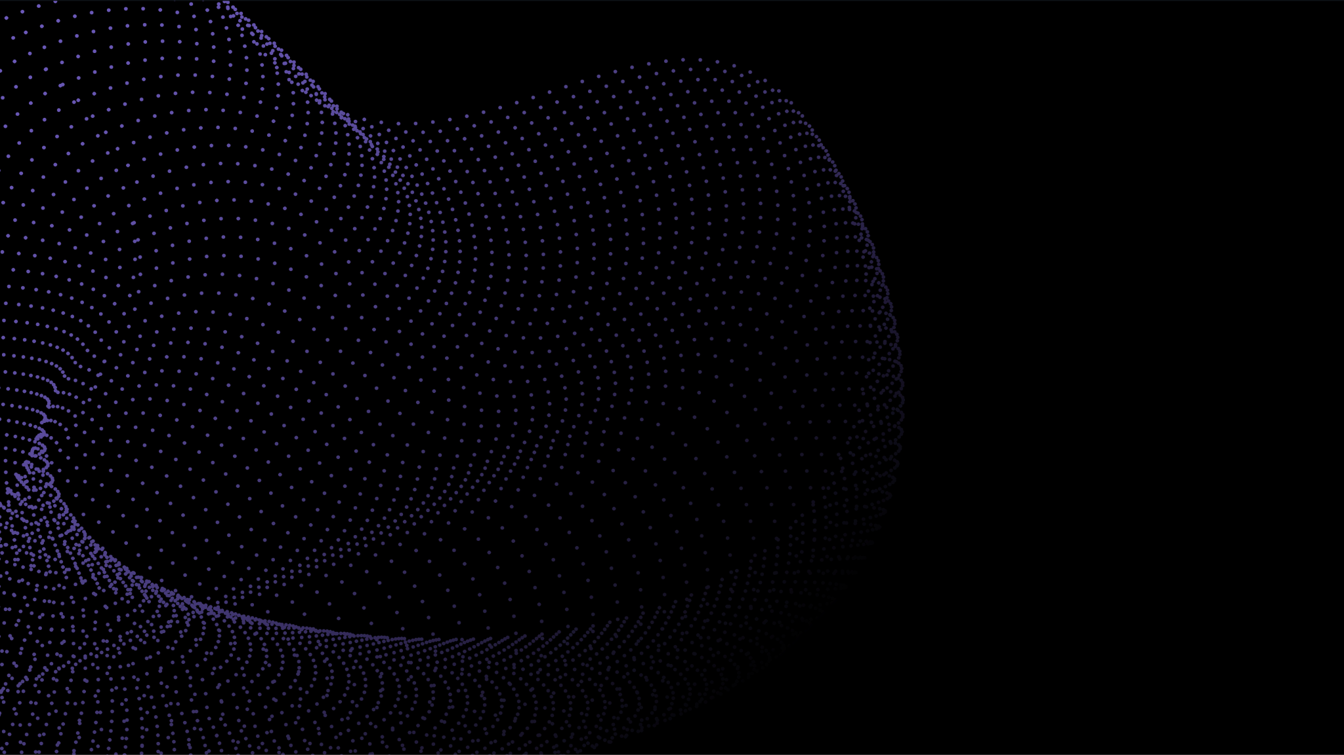
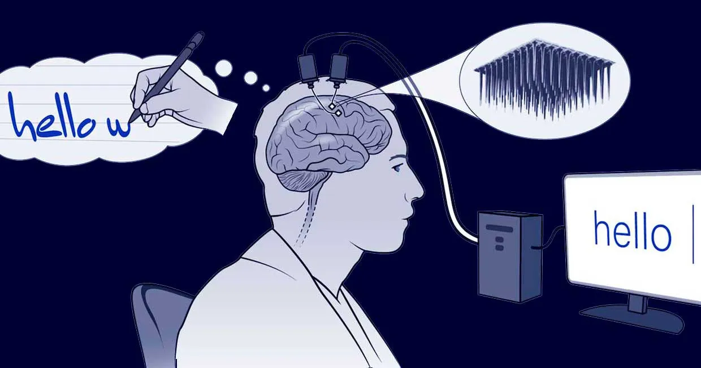
Overview
History
How the BCI works
Different types of BCI
Usage cases
Advantages
Disadvantages
Future developments
two-tiny-arrays-of-implanted-electrodes-relayed-information-from-the-brain-area-that-controls-the-hands-and-arms-to-an-algorithm-which-translated-it-into-letters-that-appeared-on-a-screen.jpg

Slide 3


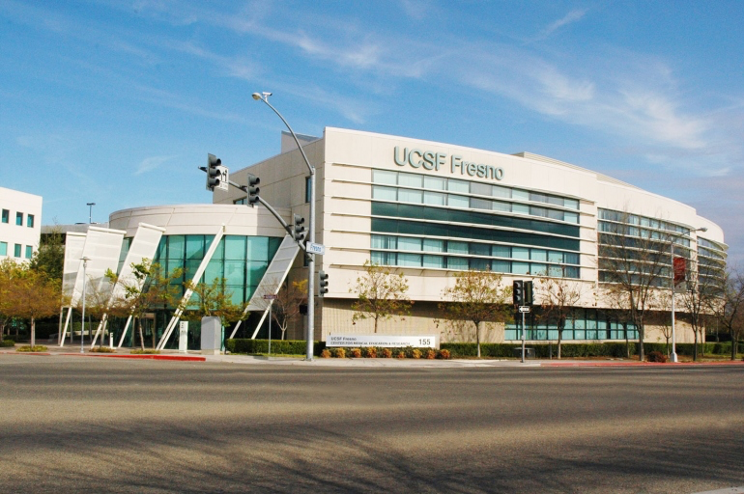
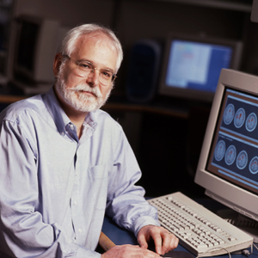
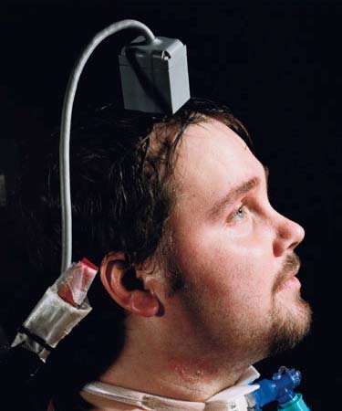
History
The University of California, San Francisco was the first to create brain computer interfaces (BCIs) in the 1970s.
In 2001, John Donoghue and a group of Brown University academics founded Cyberkinetics, a publicly listed corporation
Matthew Nagle was the first individual to be implanted with a BCI in 2004.
The University of California
2020225218525ucsf-fresno_0.jpg
John Donoghue
Matthew Nagle
john.p.donoghue.jpg
Matthew-Nagle-First-Human-Neuroprosthetic-Patient-Martin-2005.jpg

Slide 4

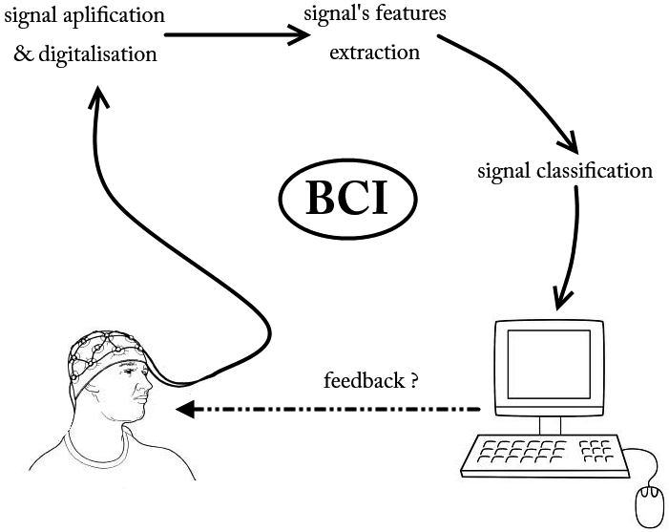
How BCI Systems Work
Detect movement of bodily parts based on brain activity
Determine whether a person is talking, adding, or doing a mental or physical task in their mind
Small electrical impulses are sent and received by brain cells to communicate with one another
Signals can be translated into commands that can be used to control a device or programme
Overall-BCI-scheme-own-work.png

Slide 5

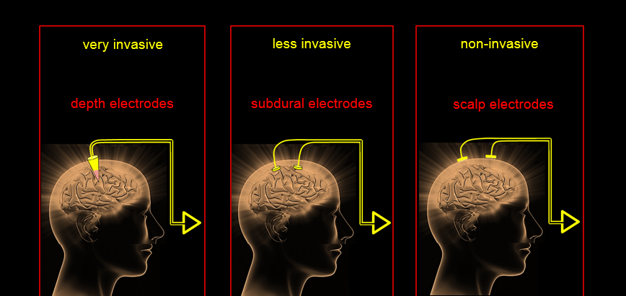
Types of BCI

Slide 6

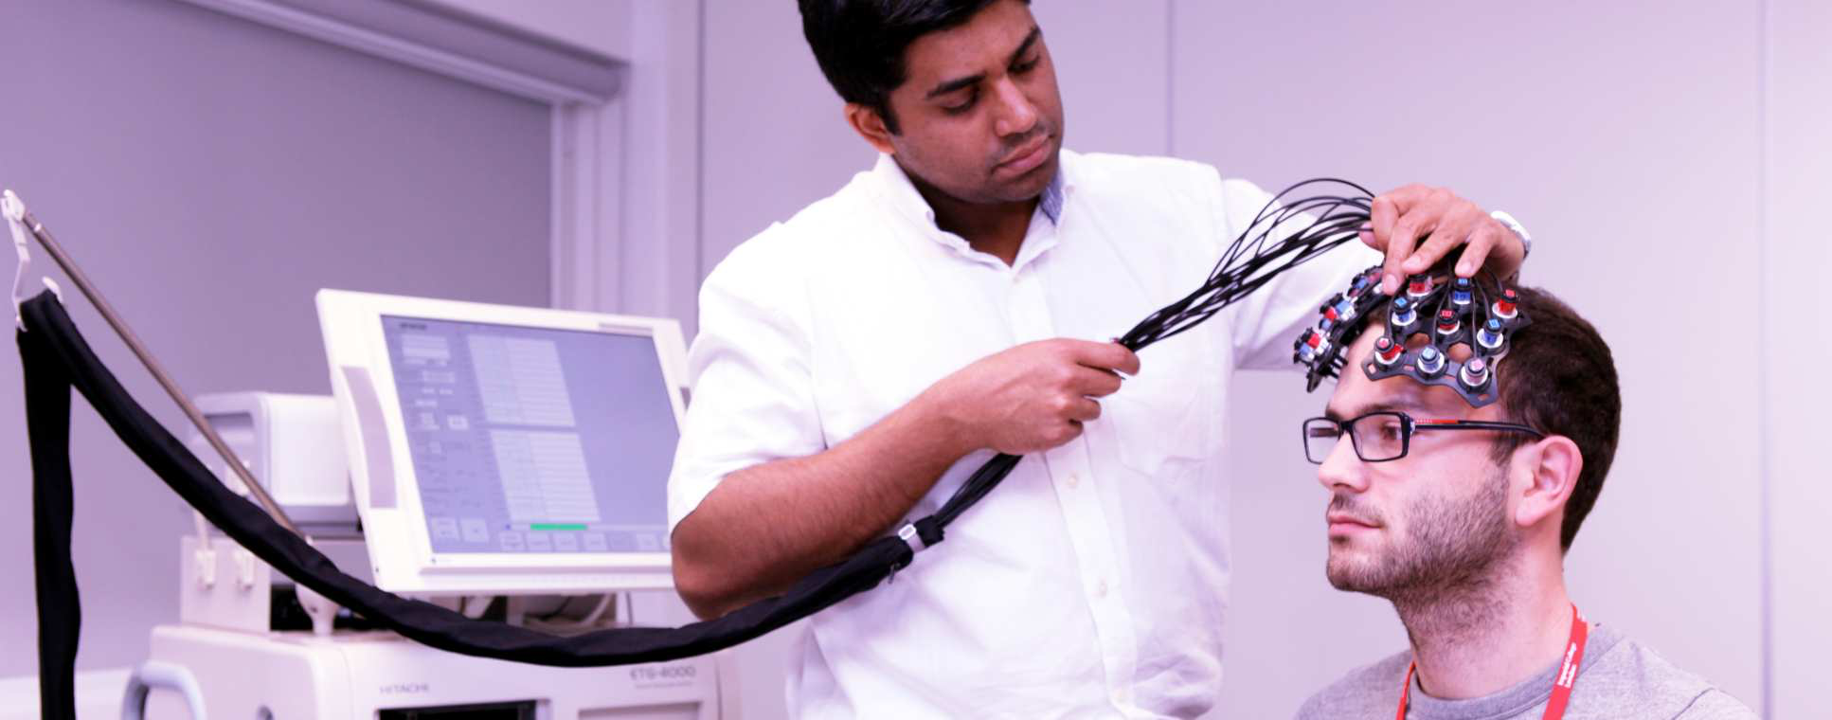
Modern Day Usage Scenarios
IMG_7124-edit--tojpeg_1439820470663_x2.jpg
Health Sector - Record brain activity and diagnose individuals
Remote Control – From operating a robotic arm to controlling home automation systems
Miscellaneous – Basically anything that could be operated with a command.

Slide 7

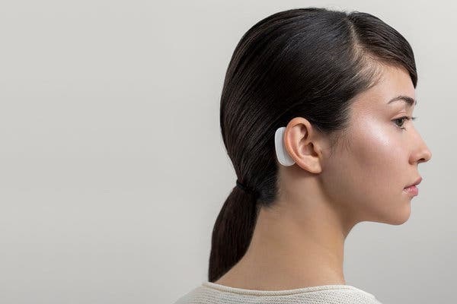
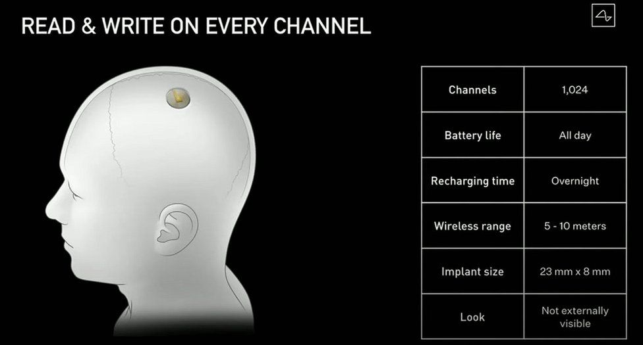
Neuralink
https://static01.nyt.com/images/2019/07/16/arts/16neuralink1/16neuralink1-articleLarge.jpg?quality=75&auto=webp&disable=upscale
https://ichef.bbci.co.uk/news/976/cpsprodpb/1543B/production/_114199078_neural.jpg
https://ichef.bbci.co.uk/news/976/cpsprodpb/1543B/production/_114199078_neural.jpg
Neuralink Wearable from the outside
Neuralink Implementation
Specifications
Introduced by Elon Musk
Wide & Multiple usage areas
Marketing & industry potential

Slide 8
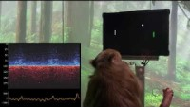
Neuralink
Video: Neuralink Demonstration

Slide 9

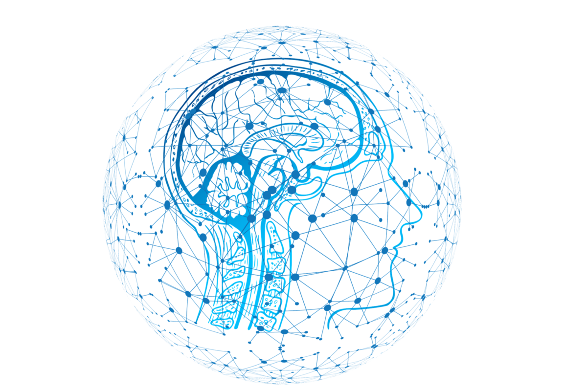
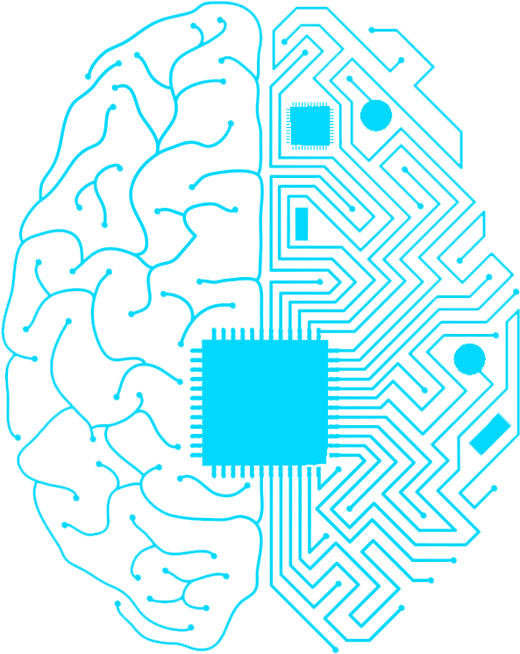
Advantages & Disadvantages
Improvement of individuals’ quality of life
Accomplishing actions that cannot be done in-person
A whole new market of technology (&integration)
Experimental & Questionable
Requires training for efficient usage
High cost, slow speed and lack of better sensor modality

Slide 10

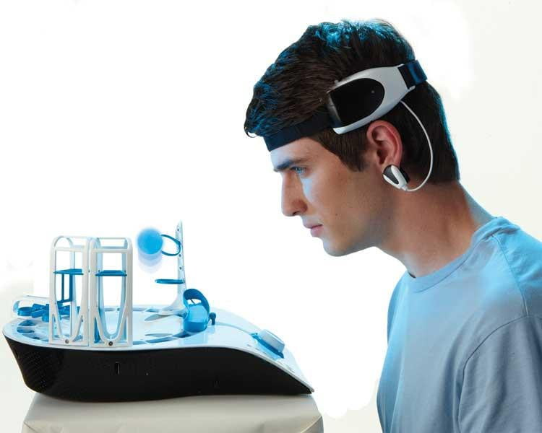
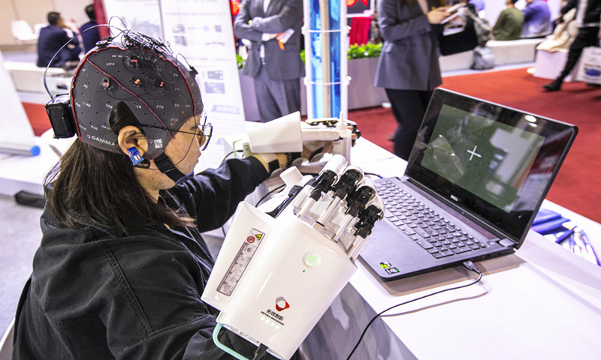
Restoration and augmentation of human functionalities thereby building a barrier-free generation
Re-defining the operation of the technologies we use everyday
Smaller chipset(s) & further capabilities
BCI Systems are still in their early-stages of development, yet their potential is limitless
mindflex-750x600.jpg
FUTURE
b9ca6925-1963-4233-9063-a9ee4f9a5608.jpg

Slide 11

References
About brain computer interface. (n.d.). Utrecht NeuroProsthesis | Communication for people with Locked-in-syndrome. https://neuroprosthesis.eu/?page_id=61
The brief history of brain computer interfaces. (2014, April 30). Brain Vision UK. https://www.brainvision.co.uk/blog/2014/04/the-brief-history-of-brain-computer-interfaces/
Renuka Kennedy. (2021, April 17). What is Neuralink? How does the technology work and what can a person do with it? Republic World; Republic World. https://www.republicworld.com/technology-news/other-tech-news/what-is-neuralink-how-does-the-technology-work-and-what-can-a-person-do-with-it.html
NeurotechEDU.
http://learn.neurotechedu.com/introtobci/(2012).
Intro to Brain Computer Interface.
https://www.mepits.com/tutorial/173/biomedical/bci-brain-computer-interface
Thank you!

